Slide 1
Business Process Testing(BPT)
Day-4
Kiran Sarpella

Slide 2
What is Business Process Testing
Business Process Testing is a methodology of testing where we can develop process based tests by building the blocks of code (Business components).
Business Process Testing enables testers to design quality assurance tests for an application early in the development cycle and in a script-free environment.
Business Process Testing uses a new methodology for testing, and its integration with testing tools such as Quick Test Professional and WinRunner, provides numerous benefits in an improved automated testing environment

Slide 3
What is Business Process Testing
Business process tests can be created in a script-free environment by Subject Matter Experts(SMEs) who best understand the business processes that need to be tested, without the need for a programming background.
Business process test creation is further accelerated by the ability to use, reusable business component units in multiple business process tests.
Ongoing test maintenance time and costs are reduced, while increasing staff efficiency.

Slide 4
Configuring BPTs
Mercury Business Process Testing is fully integrated with Quality Center. It is enabled only if your Quality Center server is licensed for Business Process Testing.
Licensing Business Process Testing for the Quality Center server enables you to access the Business Components module and provides the ability to edit business process tests in the Test Plan module.
Note: You can run test sets containing business process tests in the Test Lab module and you can also edit automated components in QuickTest Professional and WinRunner, even if no Business Process Testing license is available in Quality Center.

Slide 5
Business Components
These components provide the basis for Business Process Testing. The Business Components module enables SMEs (Subject Matter Experts) with a high-level knowledge of their application to create and manage business components in Quality Center.
You create and manage business components in Quality Center’s Business Components module. Components perform specific tasks in a business
process, and are used as the building blocks of business process tests.
The Business Components module enables you to define the business component’s shell, which comprises an overview of the information that is required at the test-creation level. You can also define manual steps for the component, and choose whether to convert it to an automated keyword-driven or WinRunner component.

Slide 6
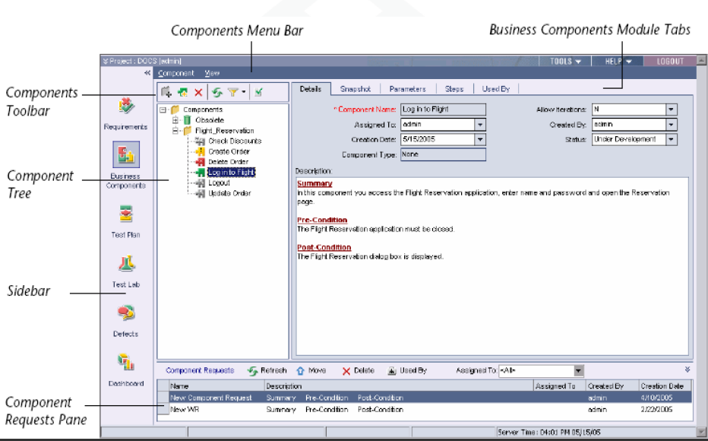
Introducing the Business Components Module

Slide 7
Key Elements in the Business Components module
Details tab — Enables you to specify details and implementation requirements for the currently selected business component.
Snapshot tab — Enables you to capture a snapshot image from the application and attach it to the currently selected business component.
Parameters tab — Enables you to define input and output component parameter values for the business component. This allows the component to receive data from an external source and to pass data to other components in the business process test flow.

Slide 8
Key Elements in the Business Components module
Design Steps tab — Enables you to create or view the steps of your business component, and provides an easy-to-understand, plain-language textual description of each step of the implemented component.
Automation tab — Enable us to Automate the default Manual component.
Used By tab — Provides details of the business process tests that include the currently selected business component. The tab also includes a link to the relevant business process test in the Test Plan module.

Slide 9
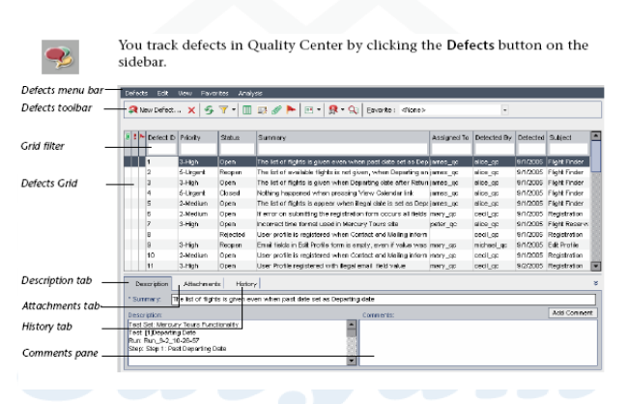
Business components statuses

Slide 10
Thank you

